Slide 1





THE PSYCHOLOGY OF COLOR IN ADVERTISING: A SURVEY-BASED EXPERIMENT
Group: Aishwarya Rauthan, Gunjan Sharma, Himani Tyagi, Jasmine Gohil, Jenil Shah

Slide 2











Slide 3


PROBLEM STATEMENT
This study aims to investigate the influence of color in advertisements on user attention and ad content processing. We hypothesize that color plays a significant role in attracting viewers' attention to the ad itself, potentially diverting focus away from the content within the advertisement.

Slide 4

HYPOTHESIS OF OUR EXPERIMENT
If color is used in advertisements, then users will pay more attention to the ad itself compared to black and white advertisements.

Slide 5

TREATMENT GROUP
Method: Survey (Random 50/50 split).
Exposure: Black & White ads
Evaluation: Attention & Perception (Visual Appeal, Overall Impression).
CONDUCTING THE EXPERIMENT
CONTROL GROUP
Method: Survey (Random 50/50 split).
Exposure: Color Ads.
Evaluation: Attention & Perception (Visual Appeal, Overall Impression).
Through a questionnaire with the help of Qualtrics

Slide 6


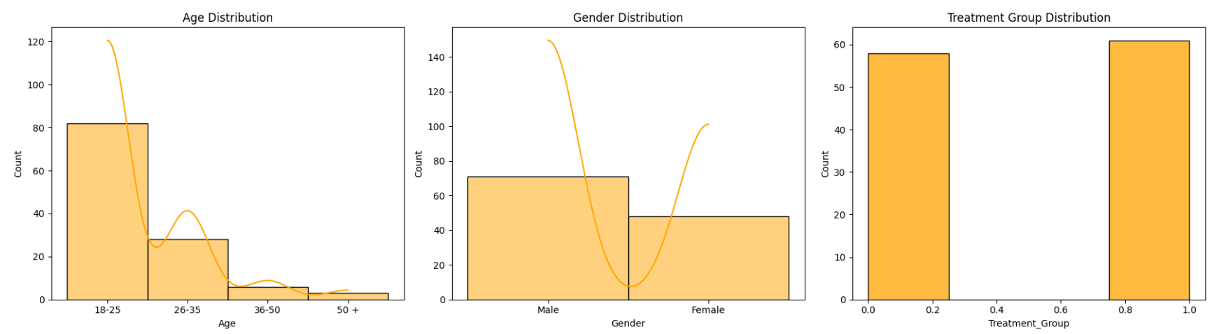
DATA INSIGHTS
Skewed right, with the majority of counts in the 26-35 age range, indicating a younger population.
There are more males than females respondents.
The counts are nearly equal across two treatment groups, suggesting a balanced experimental design.

Slide 7

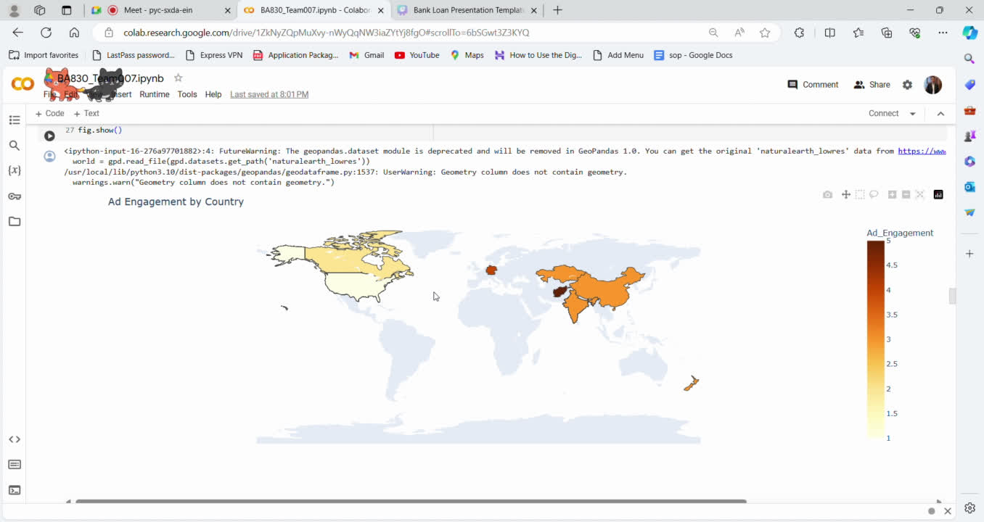
DATA INSIGHTS
High Ad Engagement: Notable in Central Asia and Russia, with Kazakhstan showing darker shades.
Moderate Ad Engagement: Lighter shades in North America indicate the USA or Canada.

Slide 8
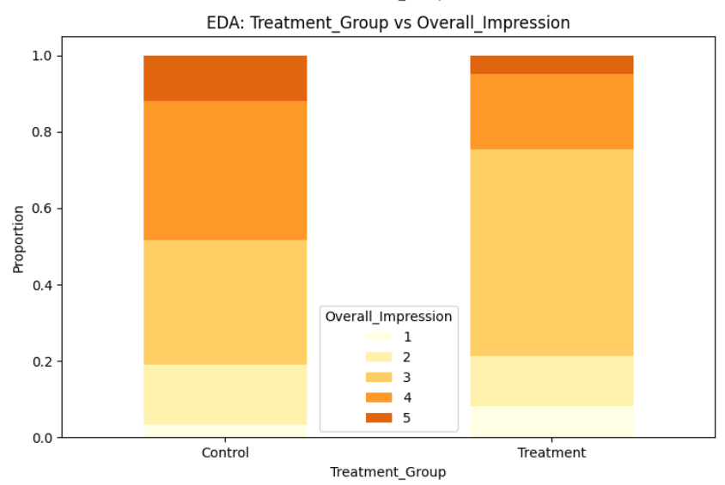
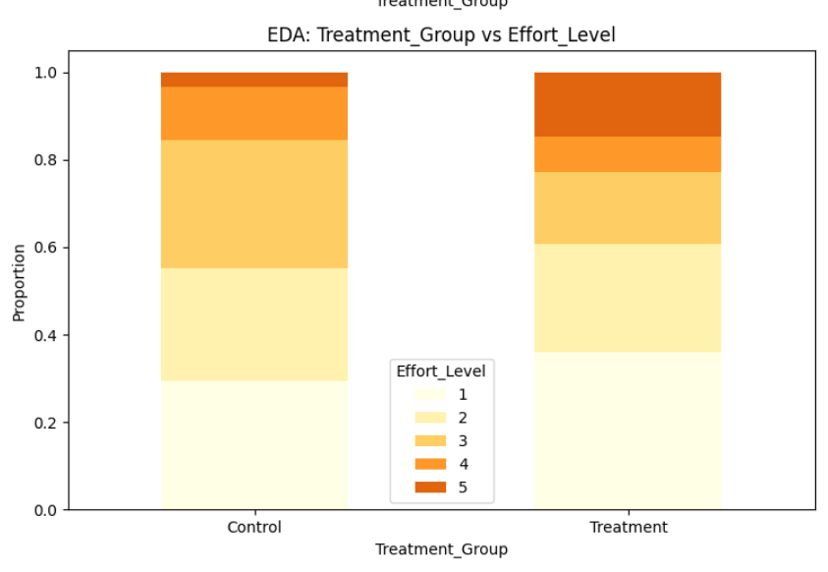
DATA INSIGHTS
Barbie Ad: The treatment group shows higher impressions for the Barbie ad, mostly ranging from moderate to high (3 to 5 on the scale).
Pedigree Ad: Respondents in the treatment group took more efforts (5 scale) to read and analyze the advertisement.

Slide 9



RESULTS
Group | Total Scores
Treatment | 1236
Control | 1272
ATE of 1.669 suggesting participants in the control group scored 1.669 points higher than those in the treatment group.
In our Regression Model, Black & White ads led to a 1.67 point decrease in total score (vs. color ads) at a 10% significance level.
Cohen’s D of 0.345 suggests that the effect size is relatively small.
Moderate Power of 48.3%, the study might not have been powerful enough to definitively identify it due to the sample size.

Slide 10

LIMITATIONS
Sample Size (n=120): May limit detection of subtle color effects.
Self-Reported Data: Attention & recall might be subjective.
Survey Format: Potential for bias due to experiment awareness.
Limited Context: Doesn't consider product type or overall ad design.

Slide 11
CONCLUSION
Key Findings: Our experiment showed a slight preference for color advertisements over black and white in terms of engagement and recall, although the effect size was relatively small (Cohen's D of 0.345).
Implications: These results suggest that while color can enhance ad effectiveness, the impact may vary depending on factors like ad content, context, and audience characteristics. This highlights the nuanced role of color in advertising.

Slide 12

THANK YOU
WE WELCOME ANY QUESTIONS YOU MAY HAVE.

